Slide 1



Gen AI with Ollama with LLama
Dr N V Ganapathi Raju

Slide 2
Ollama
Runs AI models locally → no internet needed, more privacy.
Free & open source → no subscription cost.
Works on Windows, Mac, Linux.
Easy to use → simple CLI (like Docker) and GUI available.
Can run on low-end laptops with small models.
Supports big GPUs for faster performance.

Slide 3
Limitations
Big models need strong hardware (GPU + RAM).
Limited compared to cloud AI models.
Users must do manual updates & model downloads.
Performance drops if context length is set too high.
Still less polished than commercial tools like Copilot.

Slide 4
Basic commands
ollama list: Shows all installed models
ollama pull [model]: Downloads a model
ollama rm [model]: Removes a model
ollama run [model]: Starts an interactive chat session

Slide 5
Use Cases
Advanced Chat & Personal AI Assistants
Multi-language support (stronger than Gemma in non-English tasks)
Coding & Software Development
Debugging & optimization
Business & Productivity
Automated Report Generation
Education & Research
Research paper summaries
Long-form articles, stories

Slide 6

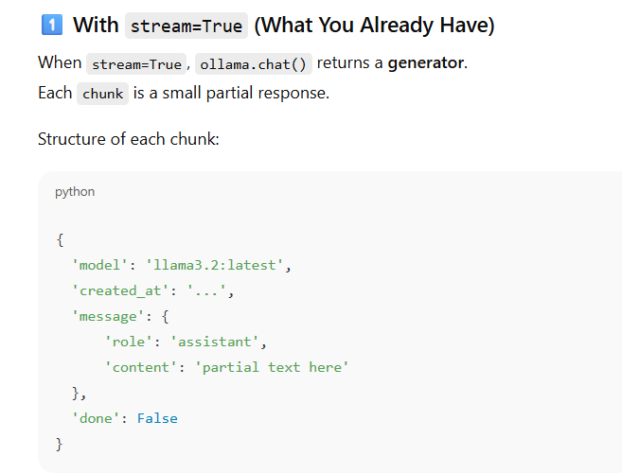

Slide 7
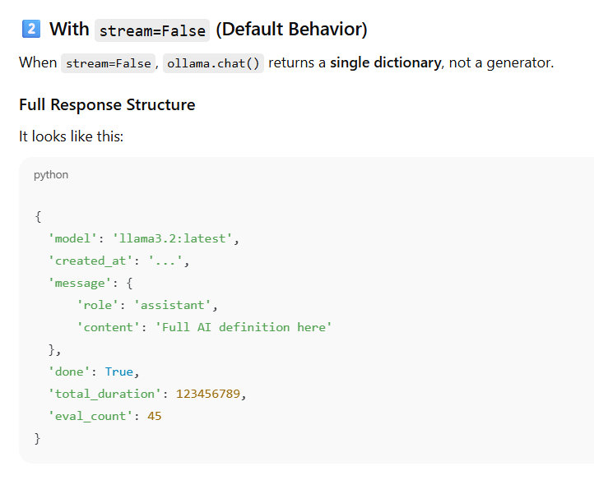

Slide 8
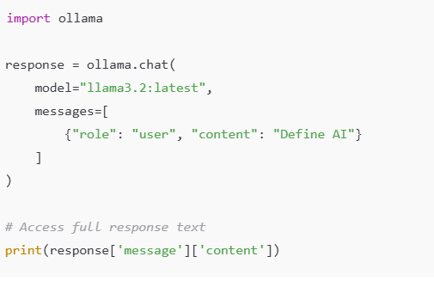

Slide 9
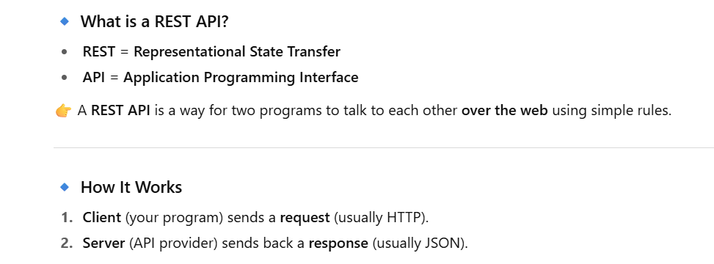

Slide 10
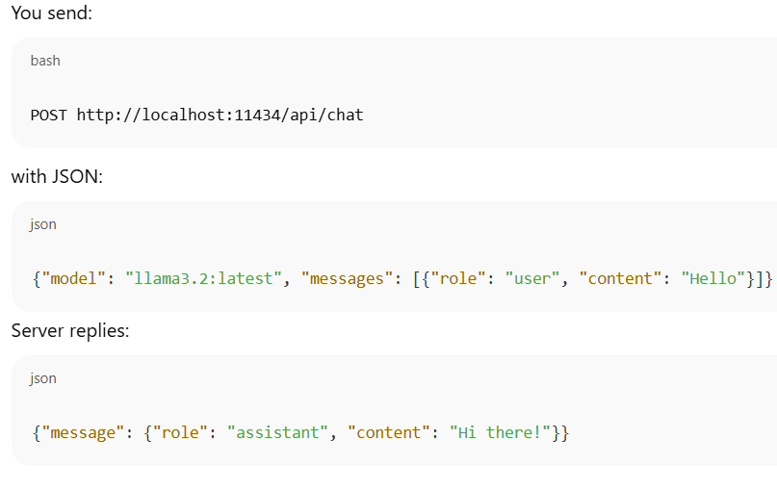

Slide 11
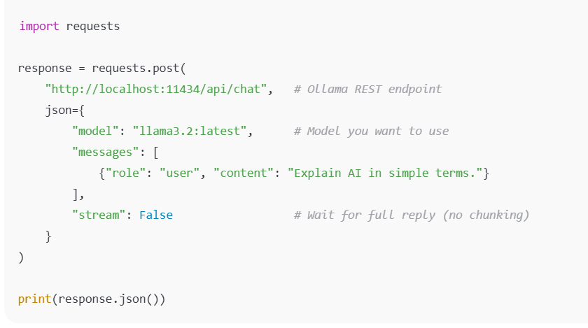

Slide 12
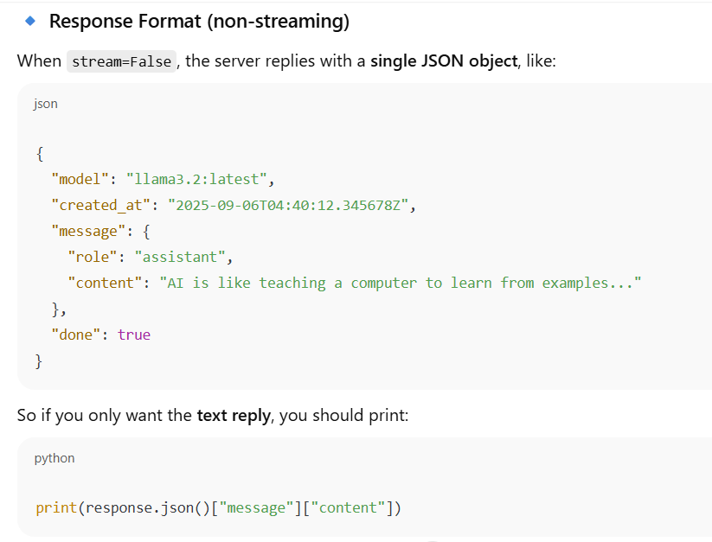

Slide 13
